Slide 1

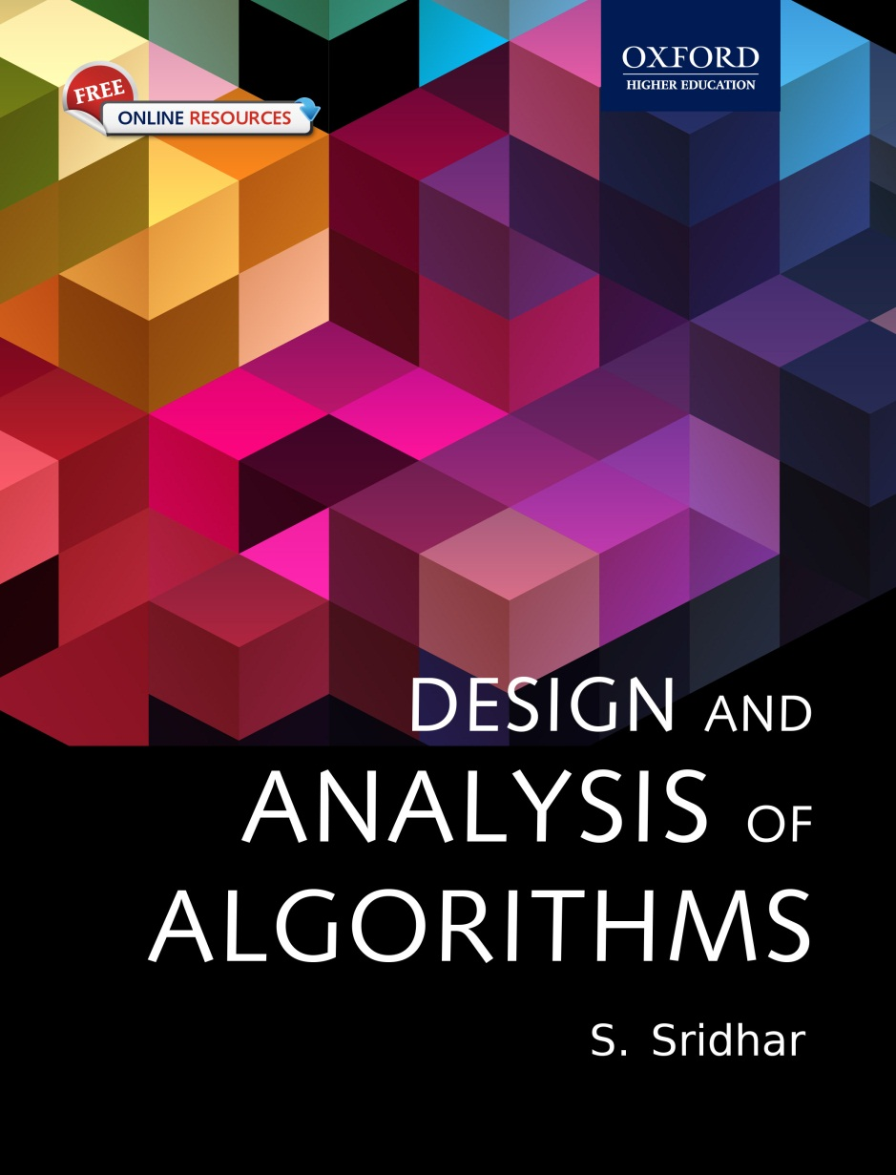
Design and Analysis of Algorithms
S. Sridhar

Slide 2
Chapter 4 Recursive Algorithm Analysis

Slide 3
Chapter Objectives
Basics of recurrence equations
Formulation of recurrence equations
Solving recurrence equations using different methods
Basics of divide-and-conquer recurrences
Master theorem for solving recurrence equations
Conditional asymptotics

Slide 4
Skills required
To analyze a recursive algorithm, two skills are basically required:
1. Formulating a recurrence equation
2. Solving the recurrence equation to understand the behaviour of the program

Slide 5
Types

Slide 6
© Oxford University Press 2015. All rights reserved.

Slide 7
Constant vs Variable Coefficient
In the generic linear recurrence equation a0tn + a1tn−1 + … + aktn−k = f(n), the terms ai can be constants or variables. Based on this fact, one can classify linear recurrence equations into two types: linear recurrence equations with constant coefficients and those with variable coefficients.
Consider the following linear recurrence equation:
tn = n × tn−2
This recurrence equation is dependent on the variable n and does not have constant coefficients.
© Oxford University Press 2015. All rights reserved.

Slide 8
© Oxford University Press 2015. All rights reserved.

Slide 9
Analysis of Framework
For example, for the sequence 1, 4, 7, 10, …, one can write the recurrence equation as follows:
T(n) = T(n − 1) + 3
T(0) = 1
It can be observed that T(0) = 1 is a base condition. From this equation, T(1) can be generated as T(0) + 3 = 4 and T(2) as T(1) + 4 = 7. Similarly, all terms of the sequence can be generated.
The preceding equation can be denoted as follows:
tn = tn−1 + 3
t0 = 0

Slide 10
Example
Example 4.1 What is the recurrence equation for the sequence 1000, 2000, 4000, 8000, …?
Solution
t0 = 1000
t1 = 2000 = 2 × 1000 = 2 × t0
t2 = 4000 = 2 × 2000 = 2 × t1 = 22t0

∴, one would guess tn = 2 × tn−1 or tn = 2n × t0
It can be observed that tn = 2 × tn−1 is the required recurrence equation of this problem. We will discuss later that tn = 2n × t0 is the actual solution of the recurrence equation as it is non-recursive.

Slide 11
Example
Design and Analysis of Algorithms
Example 4.2 Find the recurrence equation and the initial condition of the following sequence:
7, 21 4 , 63 16, 189 64 , …
Solution Let the initial condition be t0 = 7. Let us observe the patterns. Let us calculate the ratios of the successive elements as follows:
t1 t0 = 2147 = 21 28 = 34; t2 t1 = 63 16 21 4 = 63 16 × 4 31 = 34; t3 t2 = 189 64 63 16 = 189 64 × 16 63 = 34
Therefore, one can predict that tn tn–1 = 34
Therefore, tn = tn−1 × 34
Thus, one can conclude that the recurrence equation is tn = tn − 1 × 34.

Slide 12
Techniques for Solving

Slide 13
Guess and Verify Methods

Slide 14
Guess and Verify Methods

Slide 15
Example
Example 4.7 Solve the recurrence equation tn = tn−1 + 2 t0 = 1 using the guess-and-verify method.
Solution As said earlier, first make a guess of the solution and then verify it.
Guess: For making a guess, use different values of n in the recurrence equation as follows:
t0 = 1
t1 = t1−1 + 2 = t0 + 2 = 3
t2 = t2−1 + 2 = t1 + 2 = 5
t3 = t3−1 + 2 = t2 + 2 = 7

The sequence obtained (1, 3, 5, 7, …) indicates that every term differs from the previous one by 2. This is an odd-number series. Therefore, one can guess that the solution for the recurrence equation would be 2n + 1. As this is a non-recursive formula in terms of n, this can be a solution. To confirm this, one should verify the guess.

Slide 16
Examples of Input Size

Slide 19
Substitution method

Slide 20
Backward Substitution

Slide 22
Forward Substitution

Slide 23
Recurrence Tree Method

Slide 24
Recurrence Tree Method

Slide 28
Difference Method

Slide 29
Polynomial Reduction

Slide 34
Non-homogeneous Equations

Slide 37
Generating Functions

Slide 40
Procedure

Slide 44
Master Theorem

Slide 47
Akra_Bazzi Theorem
Akra–Bazzi Theorem and its Generalization
In 1998, two Lebanon-based researchers provided the solutions for the generalized form of the master theorem, which is as follows:
T(n) = h(n) for 1 ≤ n ≤ n0
aT ( a bk) + f(n) for n ≥ n0
Here, a > 0, b > 1, and n0 ≥ b are integers; h(n) is a function that is in the range d1 ≤ h(n) ≤ d2 for two constants d1 and d2 and 1 ≤ n ≤ n0; and f(n) is a positive polynomial that is in the range c1g(n) ≤ f(n) ≤ c2g(n) for all x > 0 and u ∈ nb , n. If all these conditions are satisfied and the condition a bp = 1 is true, then the solution of the recurrence is given as follows:
T(n) = Θ(np(1 + u∫1 f(u) uP+1 ))
This is a powerful theorem and solves almost all those recurrences that cannot be solved easily by other methods.

Slide 48
Example

Slide 49
Generalized Master Theorem

Slide 51
Example

Slide 52
Cases where master theorem fails

Slide 53
Transformation

Slide 54
Example

Slide 55
Range Transform

Slide 56
Example

Slide 57
Conditional Asymptotics

Slide 58
Smoothness Rule

Slide 59
Example

